Slide 1
AirBNB Price prediction challenge
A case study
KRISHNENDU MANDAL
krmandal@deloitte.com

Slide 2
Objective:
Predicting the prices of properties on the basis of available information of various attributes and finding out the answers to the below questions from data exploration:
1. What are the most popular amenities being offered by different hosts?
2. Which neighborhoods are most popular amongst tenants and the price trends in those neighborhoods?
3. What are the most important features of a listing, and how do they influence price?

Slide 3
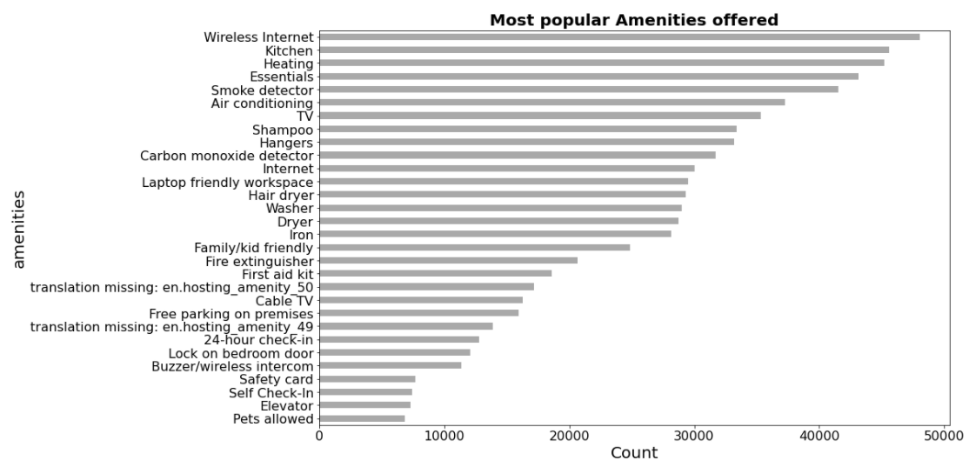
Most popular amenities offered:
From our exploration we could see that “Wireless Internet”, “Kitchen” and “heating” are the most popular amenities and “must to have”. But can we say these amenities will drive the price up? not from this data at least.

Slide 4
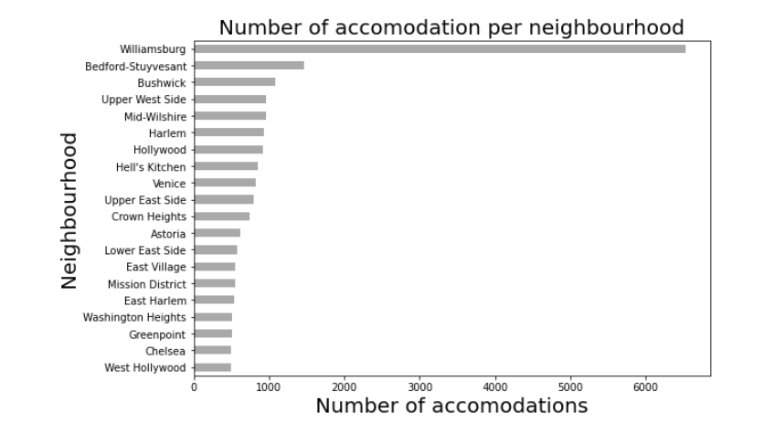
Availability of properties in neighborhoods:
We can see from the visualization that In terms of “number of accommodation” “Williamsburg” is the place with most number of properties.
There is a huge difference in number of properties between the 1st place and the 2nd place which is “Bedford-Stuyvesant”.
What could be the reasons behind so many properties being present in Williamsburg? Is it driven by demand? Is it a business district with many offices? Is it well connected with other major neighborhoods? If that is so then the price should be reasonable here in this area.

Slide 5
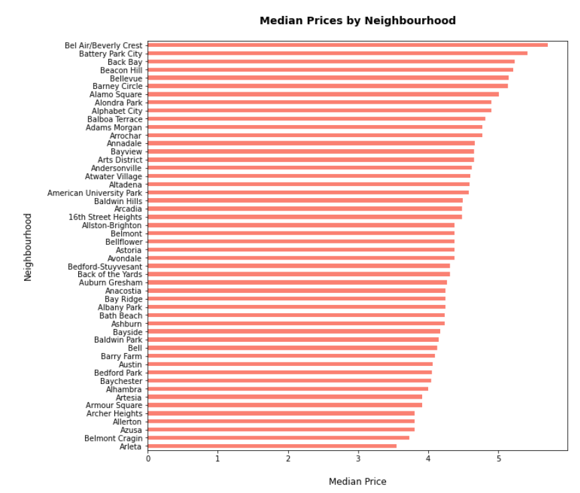
Price trend in neighborhoods top 50 (descending order)
In terms of Median price of the property “Bel Air/Beverly Crest” is at the top with median price around 5.7! Closely followed by “Battery Park City”.
Another interesting point to note that
“Williamsburg” is not in this list, that means the median price is comparatively low in the area henceforth demand is more and that is why there are so many properties being set up to manage the demand.
But “Bedford-Stuyvesant” is in the list with median price of properties lingering around 4.2.

Slide 6
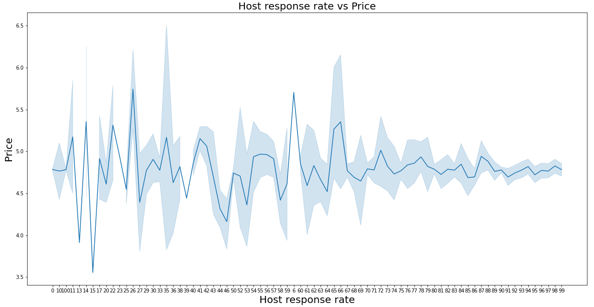
Does Host response rate impact Price?
As we know a humble and responsive host makes a lot of difference, tried to figure out whether the data in our hand says the same thing or not.
From the visualization we can see that there are peaks where the response rate is low, where as the price is stable where the response rate is on the higher side and its around 4.8! From this visualization we can not draw any conclusion whether a better response rate leads to higher price.

Slide 7
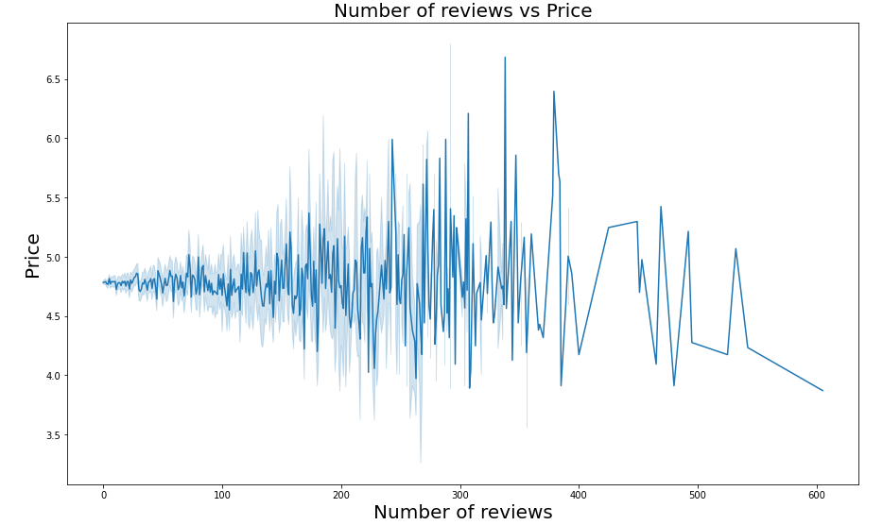
Does number of reviews impact price?
In todays world number of reviews plays an important role for customers to decide which property to pick.
Though higher number of reviews does not guarantee a high price but number of good reviews in those total reviews definitely matters.
We can see the properties with reviews in the range 250 – 380 are fetching some good price. May be the percentage of good reviews are on the higher side!
On the other hand places with higher number of reviews are unable to attract good prices! So definitely reviews and price are not proportional.

Slide 8
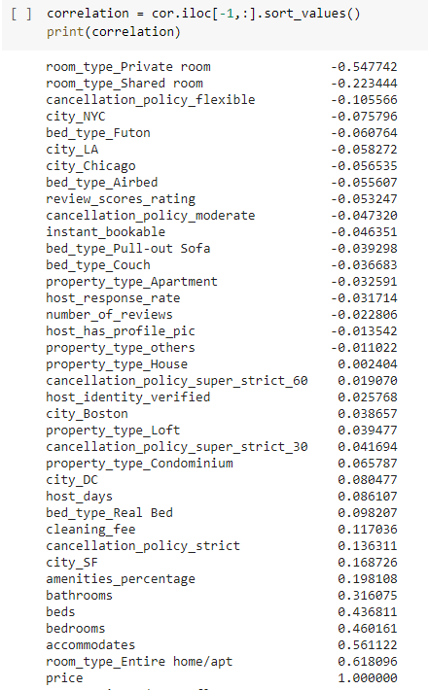
Features highly correlated with price:
From the table we can easily figure out that bathrooms, beds, bedrooms, accommodates and room_type_entire home/apt are positively correlated with price, where as private room and shared room are negatively correlated with price.
Whole apartment or home with more capacity to accommodate people, with more bed, bedrooms and bathrooms are pulling the prices up and properties with shared rooms and private rooms are fetching low prices. Private room could accommodate only single person and family/friends are may not allowed, may be that is why it is negatively correlated. Where as Entire_home/apartment can accommodate the a group of friends/family hence positive correlated with price.

Slide 9
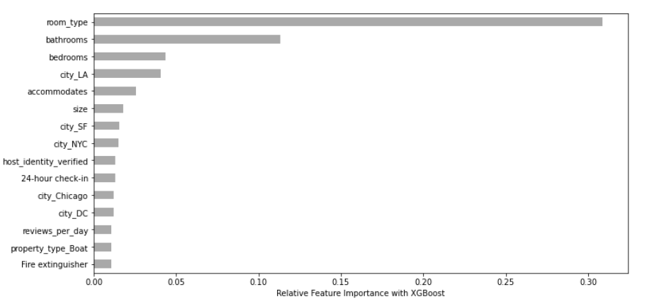
Important features for determining price
The chart depicts the most important features that can explain the maximum variance in our target variable which is price in this case.
Just like the previous slide we can see here also that “room_type”, “bathrooms”, “bedrooms” explain the maximum variance in price.
There are other features as well but those are lagging quite a bit!
To determine the price of any property, the features shown in this chart play a major role.

Slide 10
Further scope:
There are more to be explored in this case study.
How does the longitude and latitude impact the price.
How can we extract more insights from the column “Zip code”? We have removed that column here as we already had “city” column available in the data set. But may be we can extract some valuable insights from that feature.
Refining the model for more accurate results.
Optimizing the run time of the model to make it more efficient.

Slide 11
Thank you.

